Slide 1
Final Game
-- Fruit Fall Frenzy
Comprehensive Development Project
Ariel Zhao Liu
GEX - Sr. Winter 2025

Slide 2
CONTENTS
01
02
Game Overview
GameFlow
03
04
Main Functions and Codes
Acknolegements

Slide 3
Game Overview
01

Slide 4
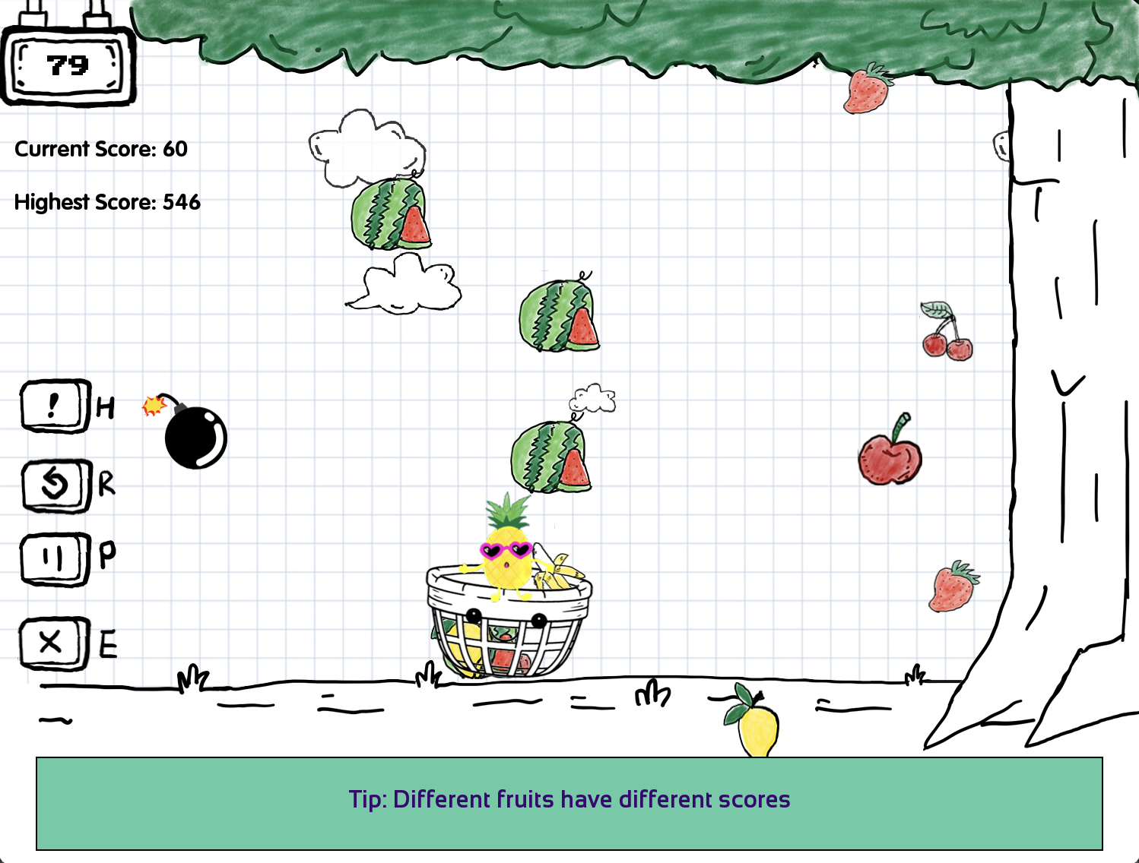
Game Overview - Fruit Fall Frenzy
Concept: A magical fruit tree is under attack by mischievous spirits. Players must protect the tree by catching falling fruits to score points and avoid bombs that reduce points and time. The gameplay becomes progressively challenging with increasing fruit and bomb speeds.
Assets: By personally hand drawn. Some of artwork is based on images I studied online but was redrawn by hand. Using iPad + iPencil, Notability, Photoshop.

Slide 5
Game Flow
02

Slide 6
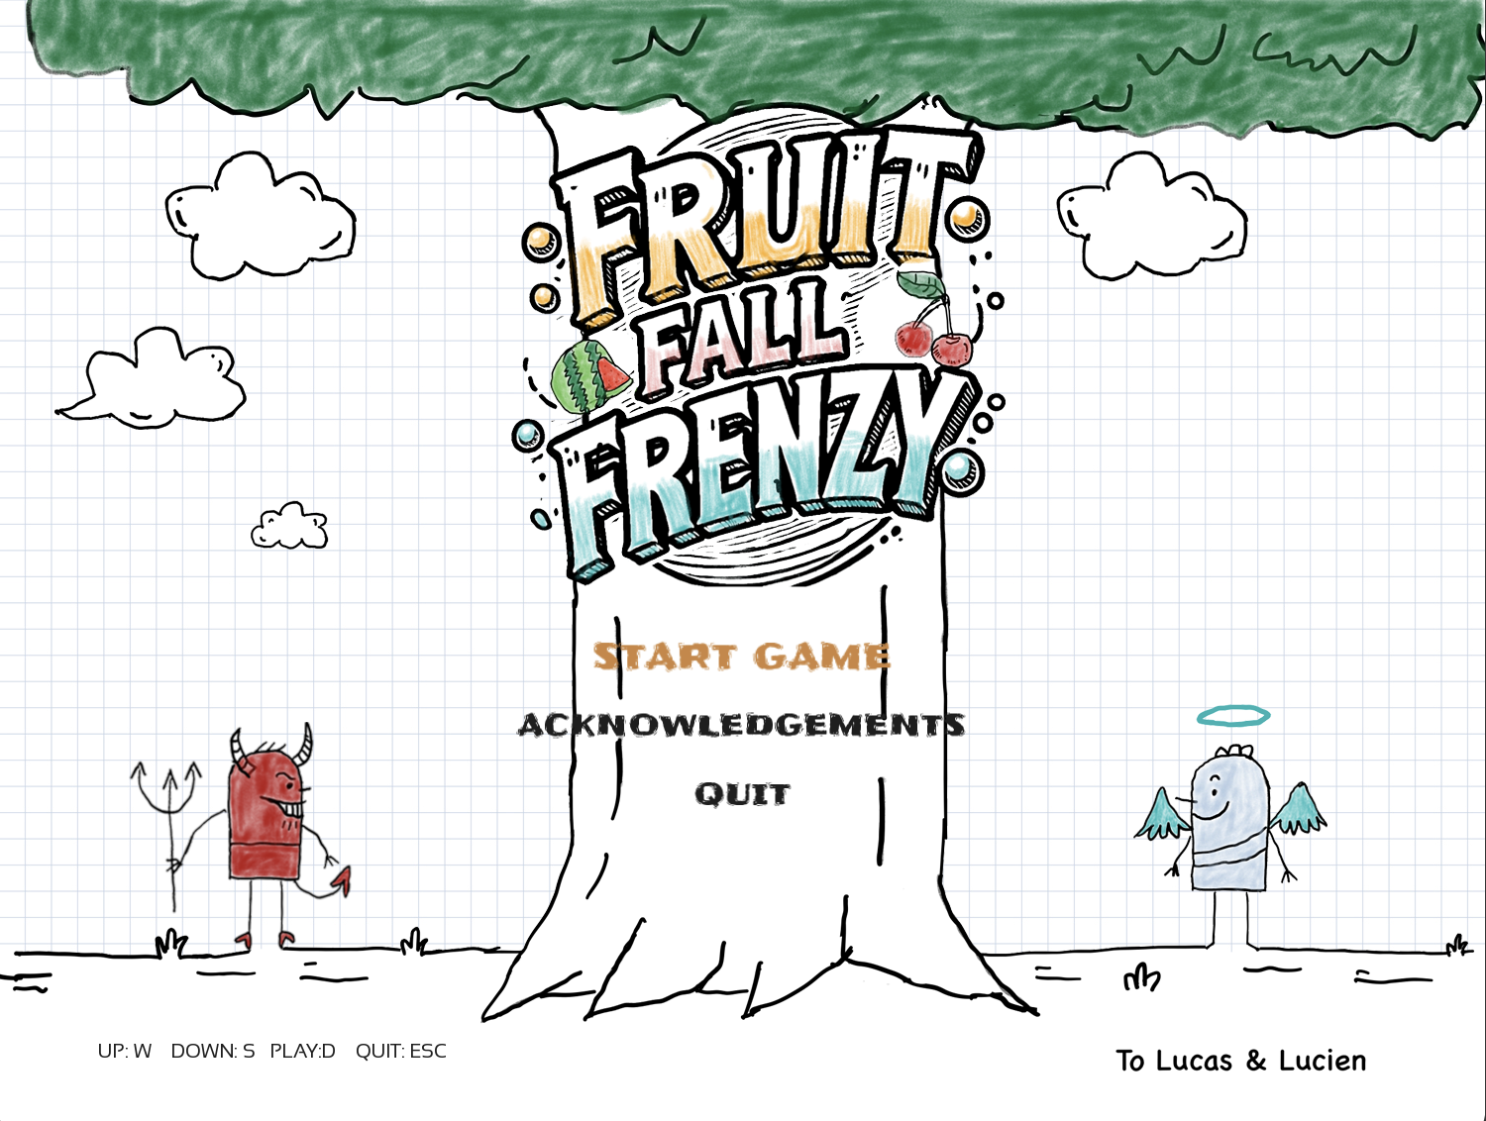
Main Menu

Slide 7
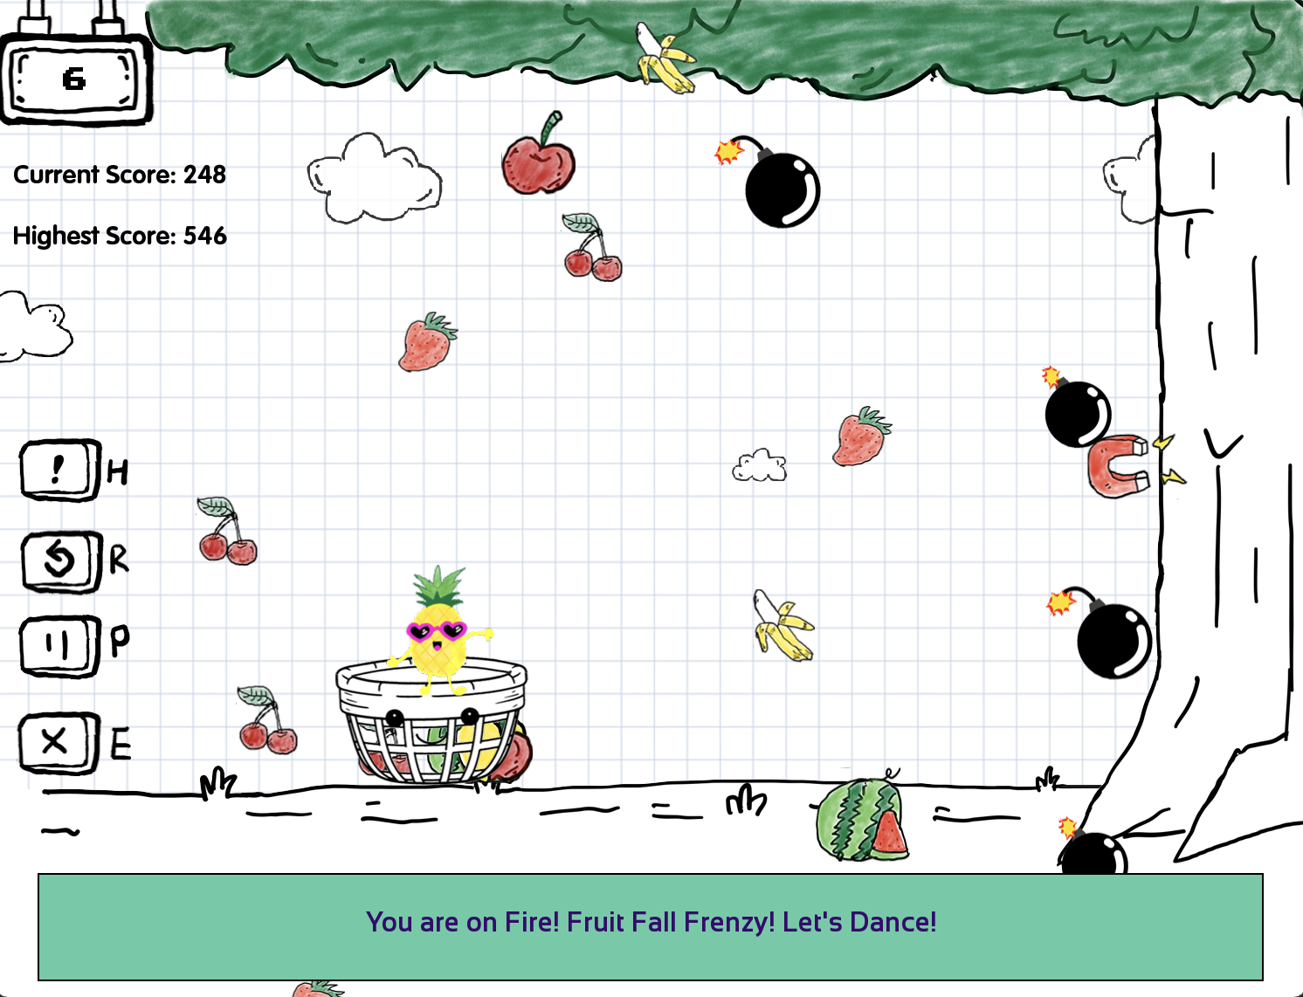
Gameplay Screen
Notes:
Player, Scores, Time, Meun,

Slide 8
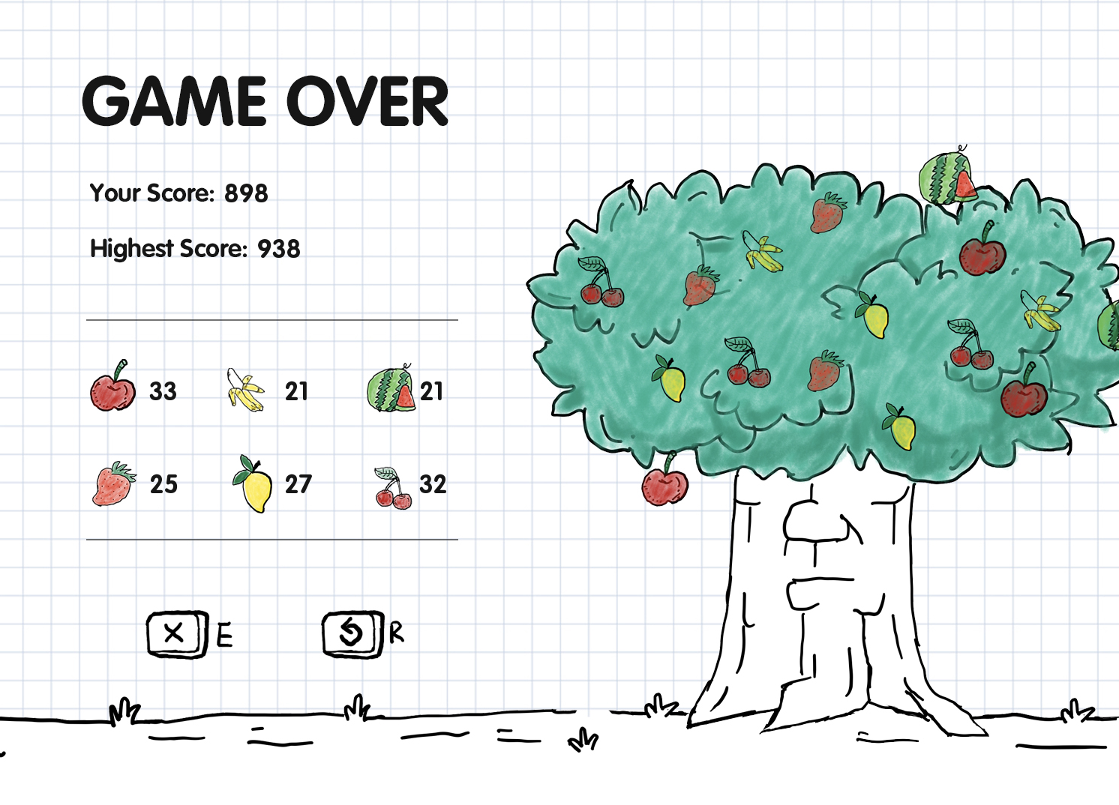
Game Over Screen
Notes:
Win status, score, replay or exit

Slide 9
Main Functions and Codes
03

Slide 10
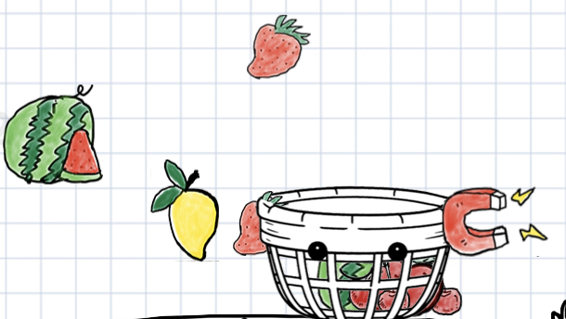
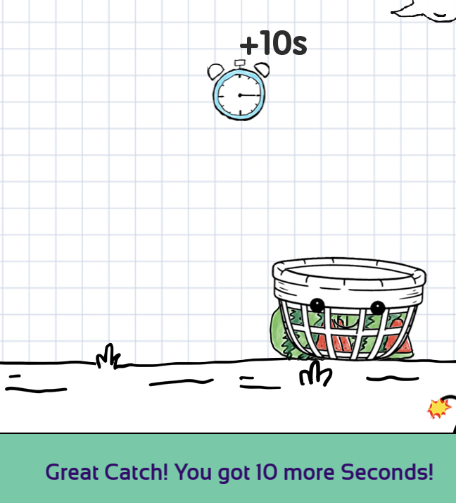
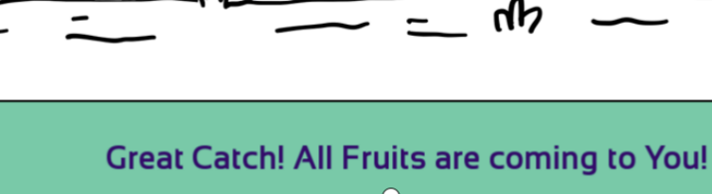
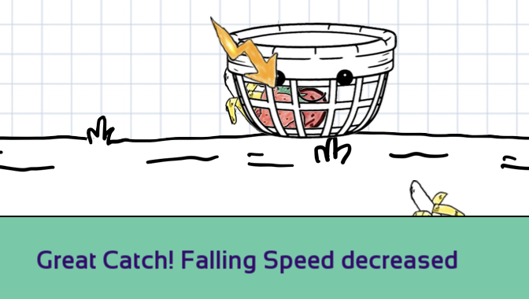
3.1 Power Ups Effect

Slide 11
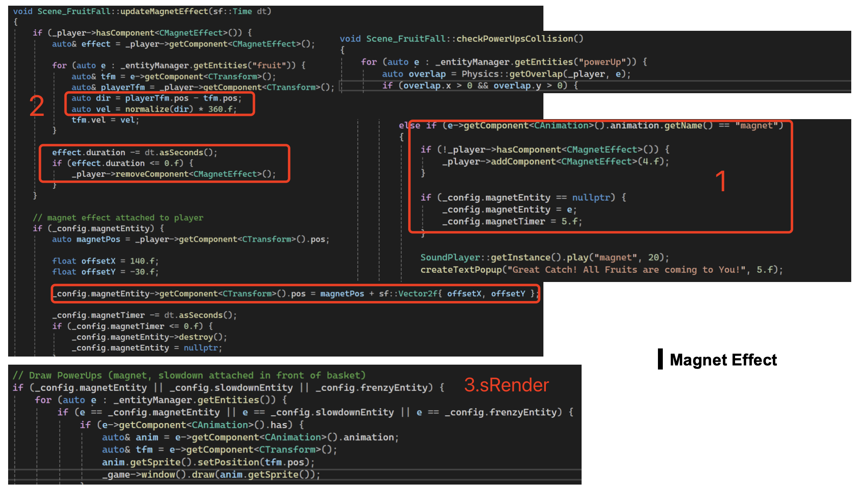
Notes:
loose status, replay or exit

Slide 12
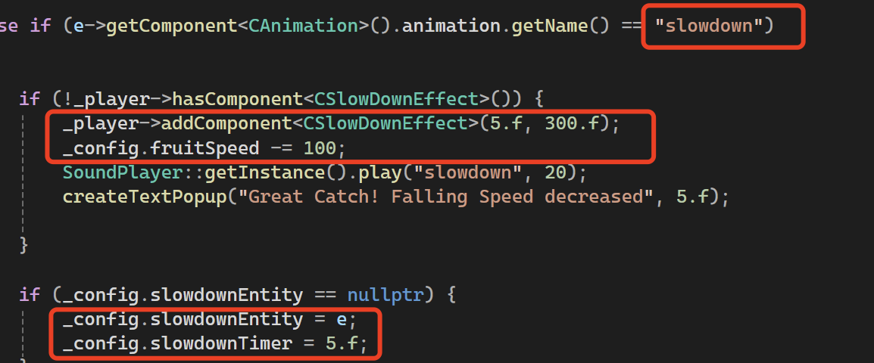
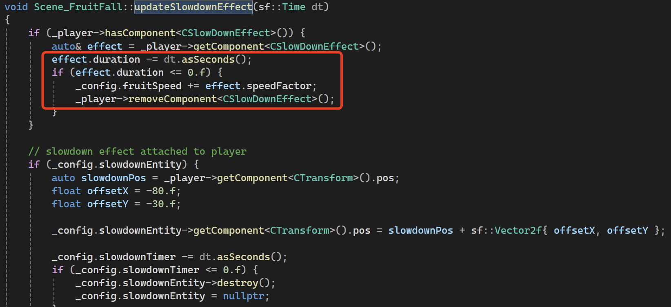
Slowdown Effect
Notes:
loose status, replay or exit

Slide 13
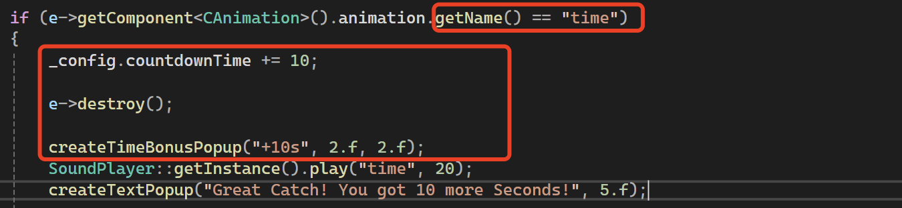
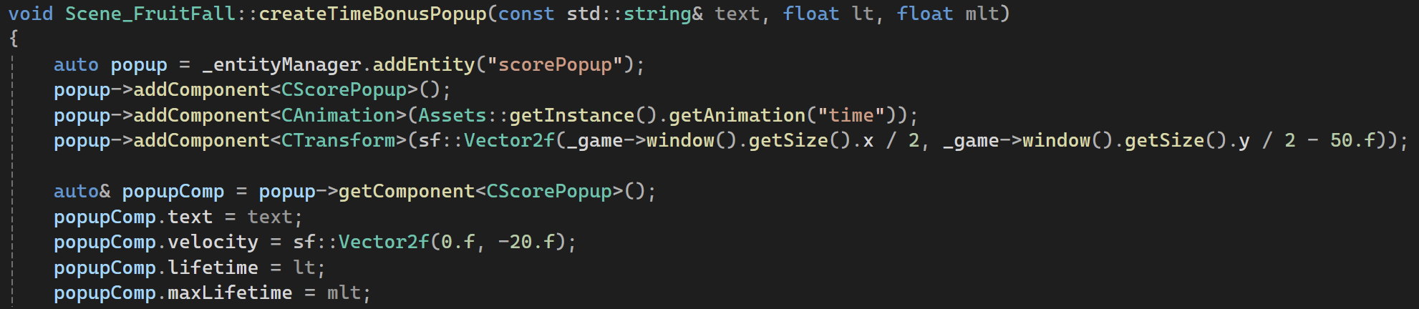
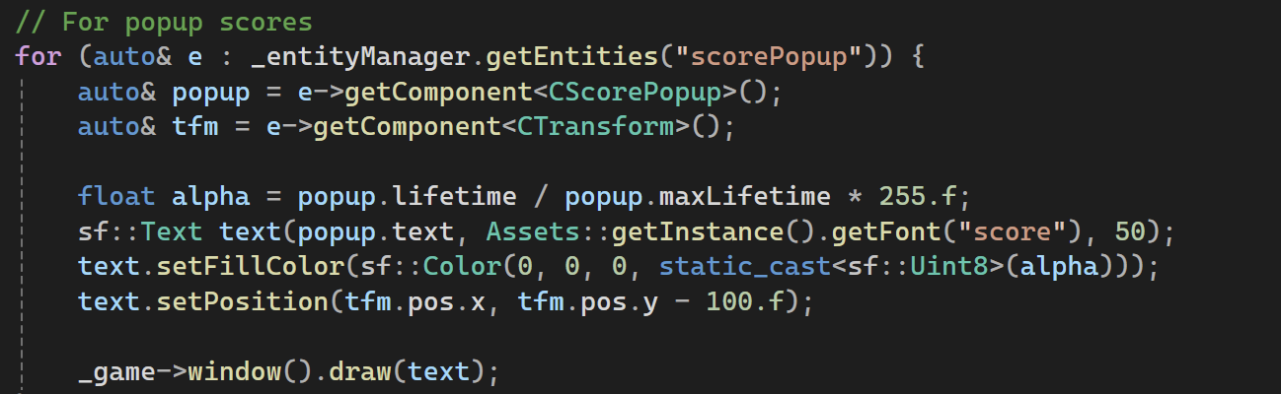
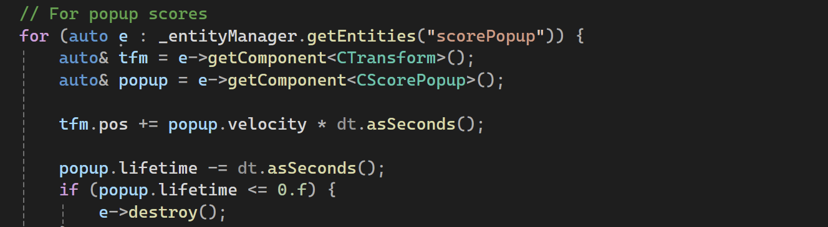
Time Effect
Notes:
loose status, replay or exit

Slide 14
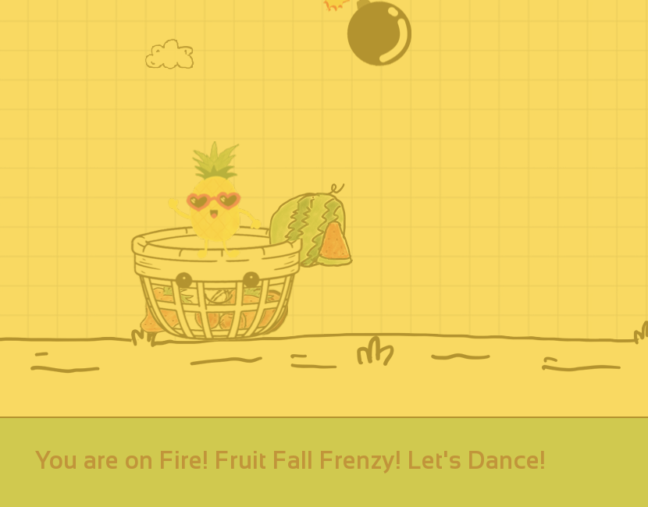
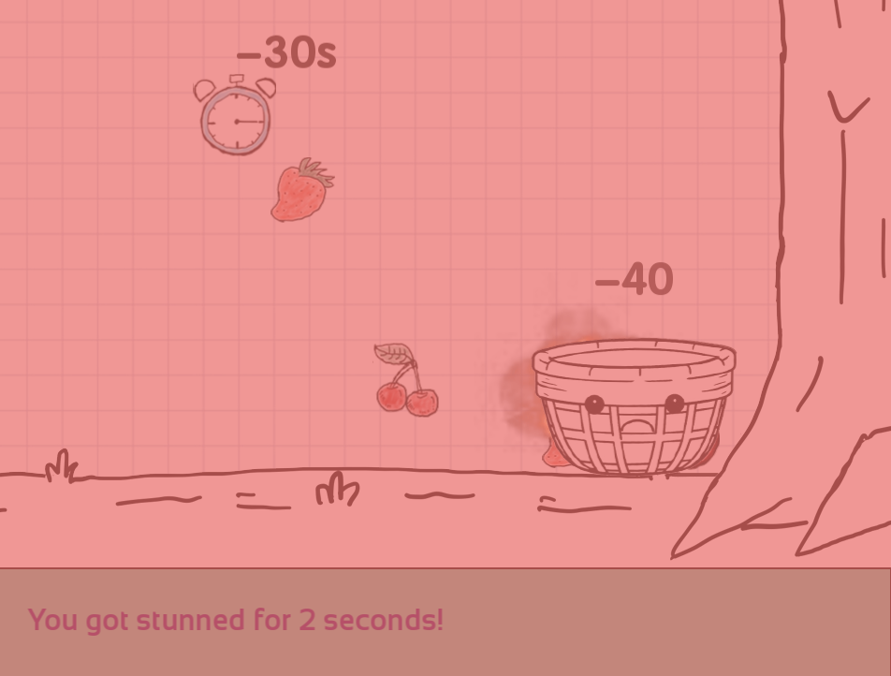
3.2 Frenzy V.S. Bomb

Slide 15
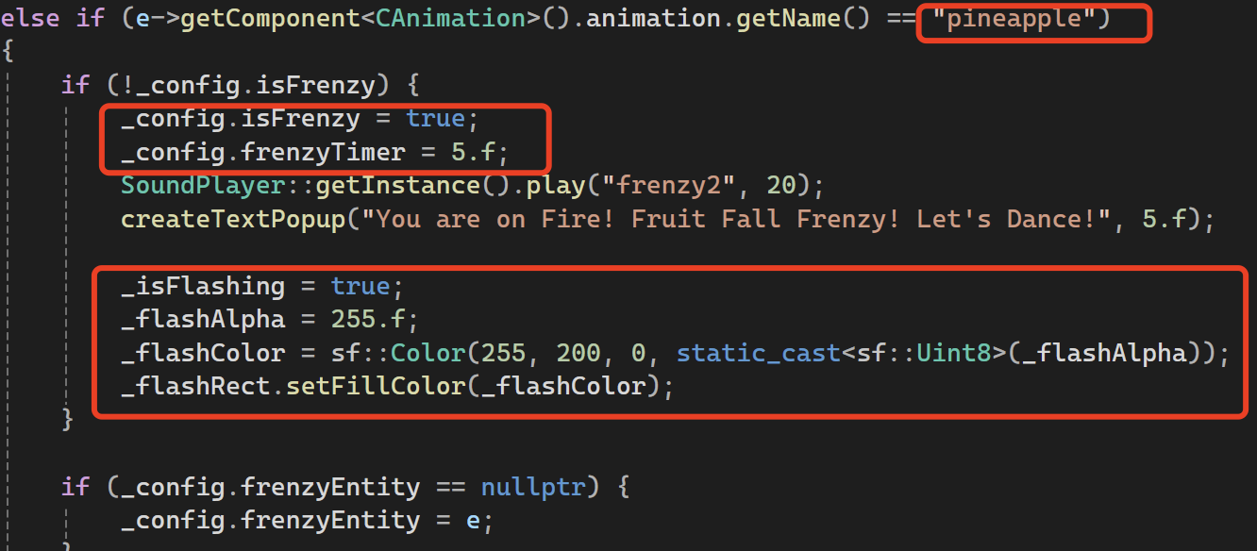
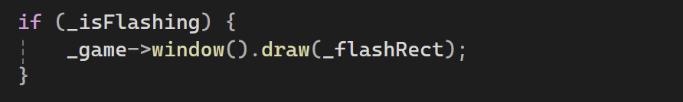
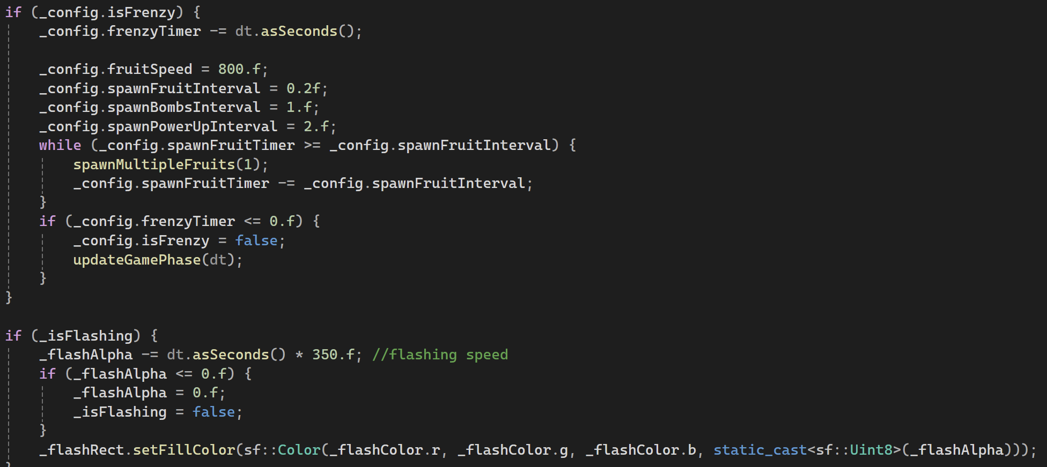
Frenzy Effect
Flashing
Notes:
loose status, replay or exit

Slide 16
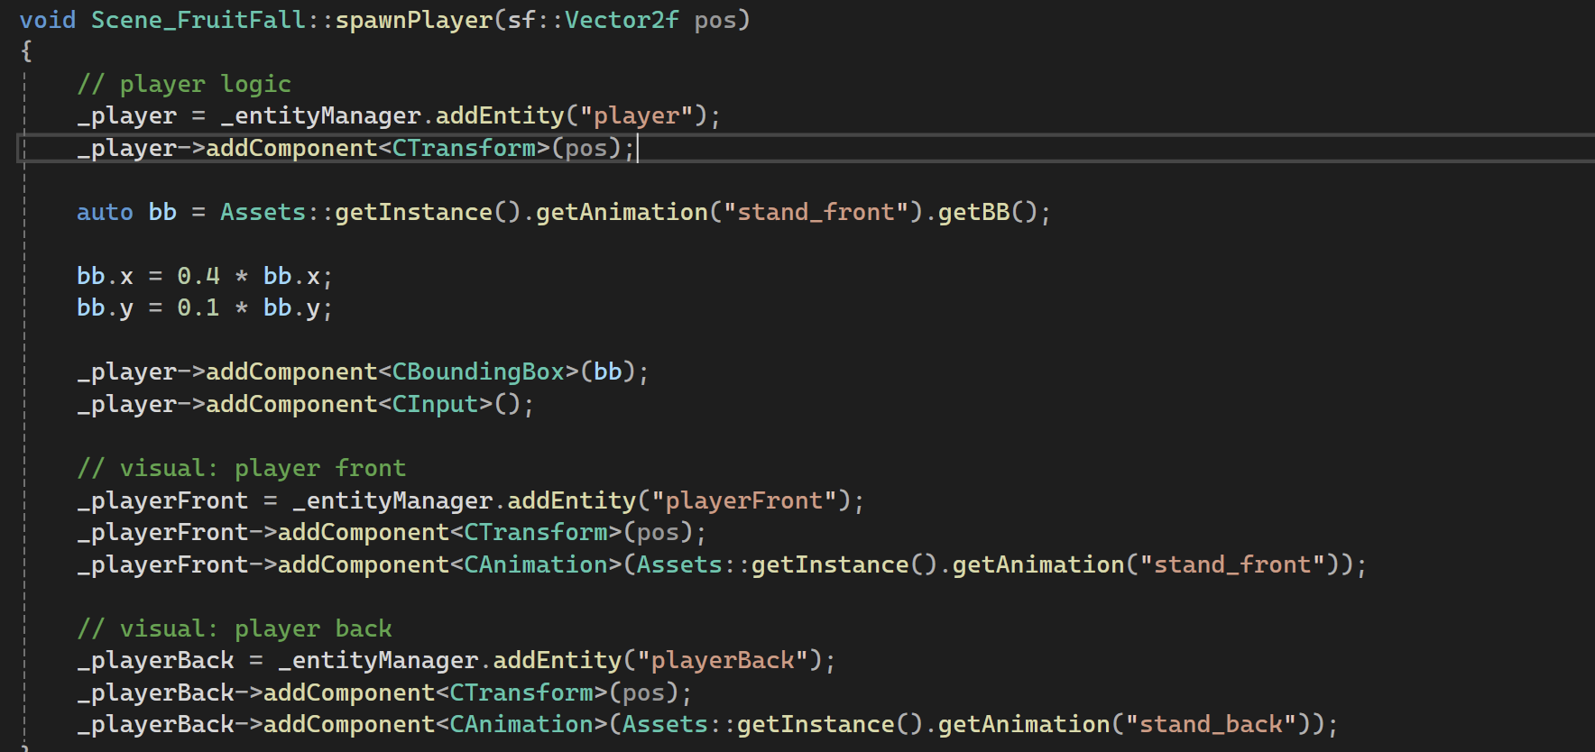
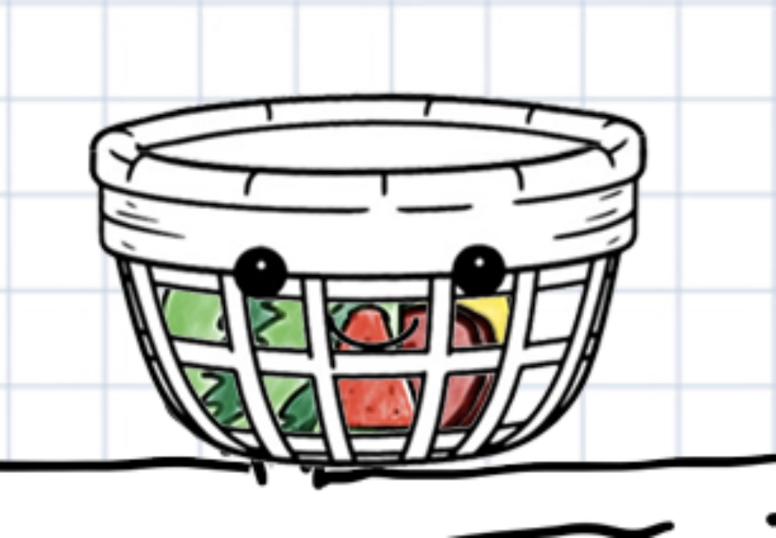
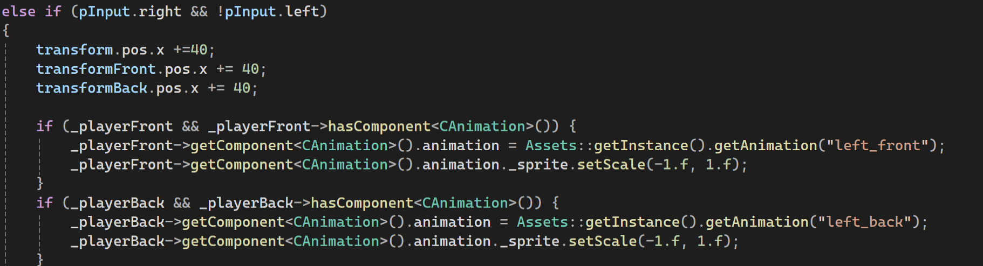
Transpanrent Basket
Notes:
loose status, replay or exit

Slide 17
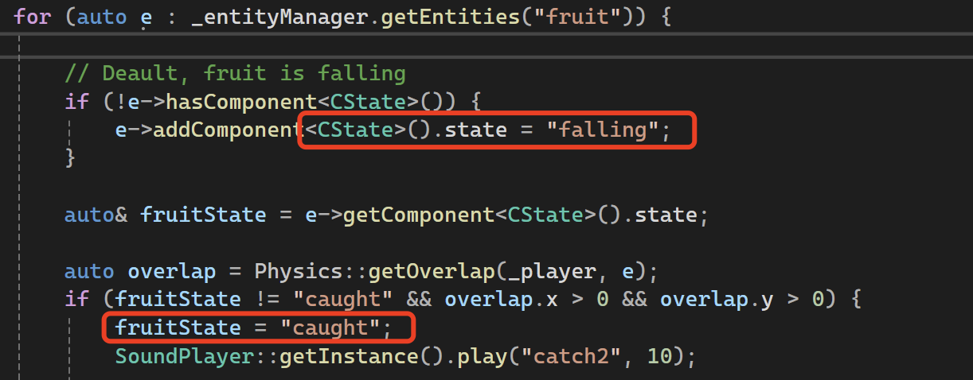
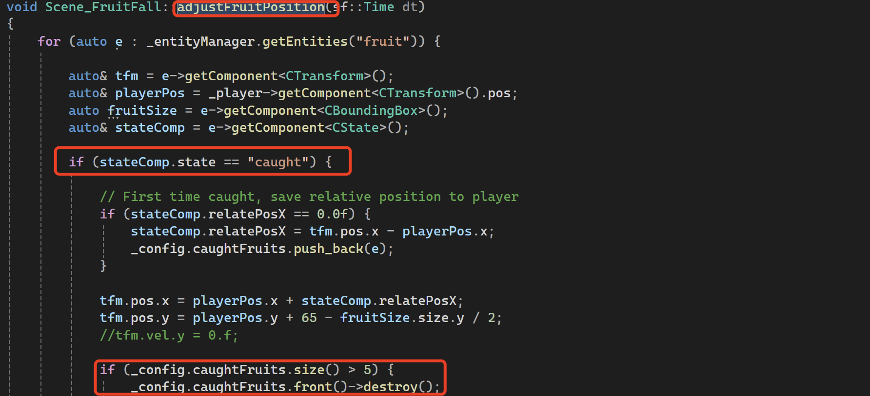
5 Fruits caught
in the Basket
Notes:
loose status, replay or exit

Slide 18
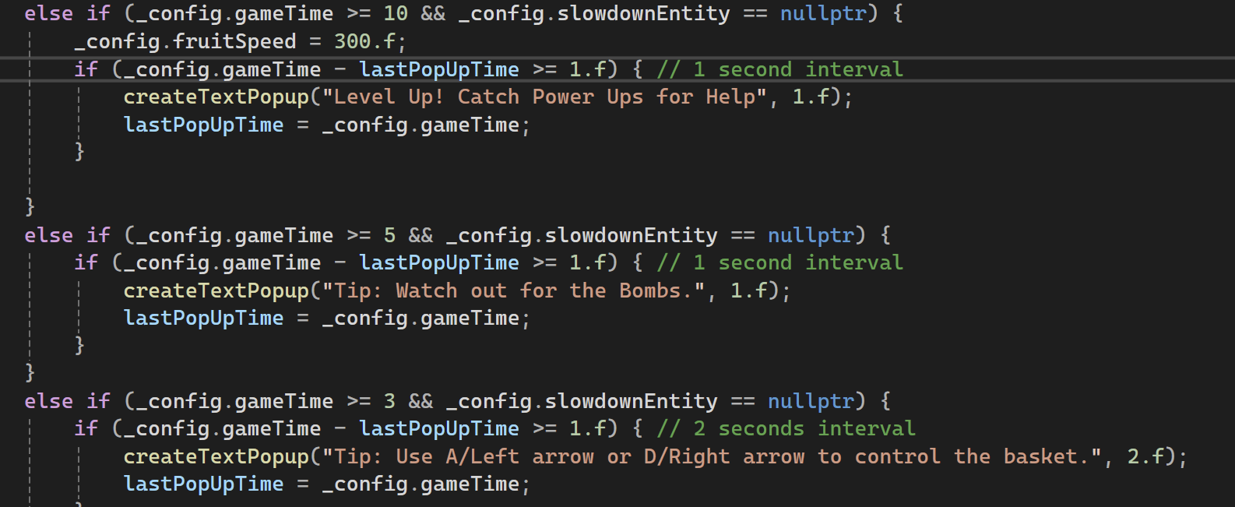
3.3 Progression
Game Progression: eg.
0–5 seconds: A few fruits fall with no bombs.
5–10s: A few bombs are introduced, and the fruit speed is moderate.
After 10s: The falling speed increases slightly.
After 15s: Random power-ups start to appear.
After 30s: The falling speed increases further.

Slide 19
Acknolegements
04

Slide 20
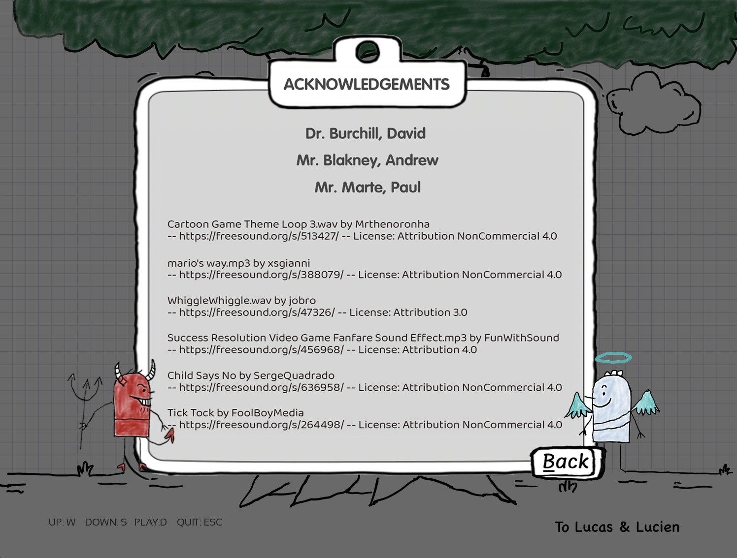

Slide 21
THANK YOU
Ariel Zhao Liu

